Slide 1
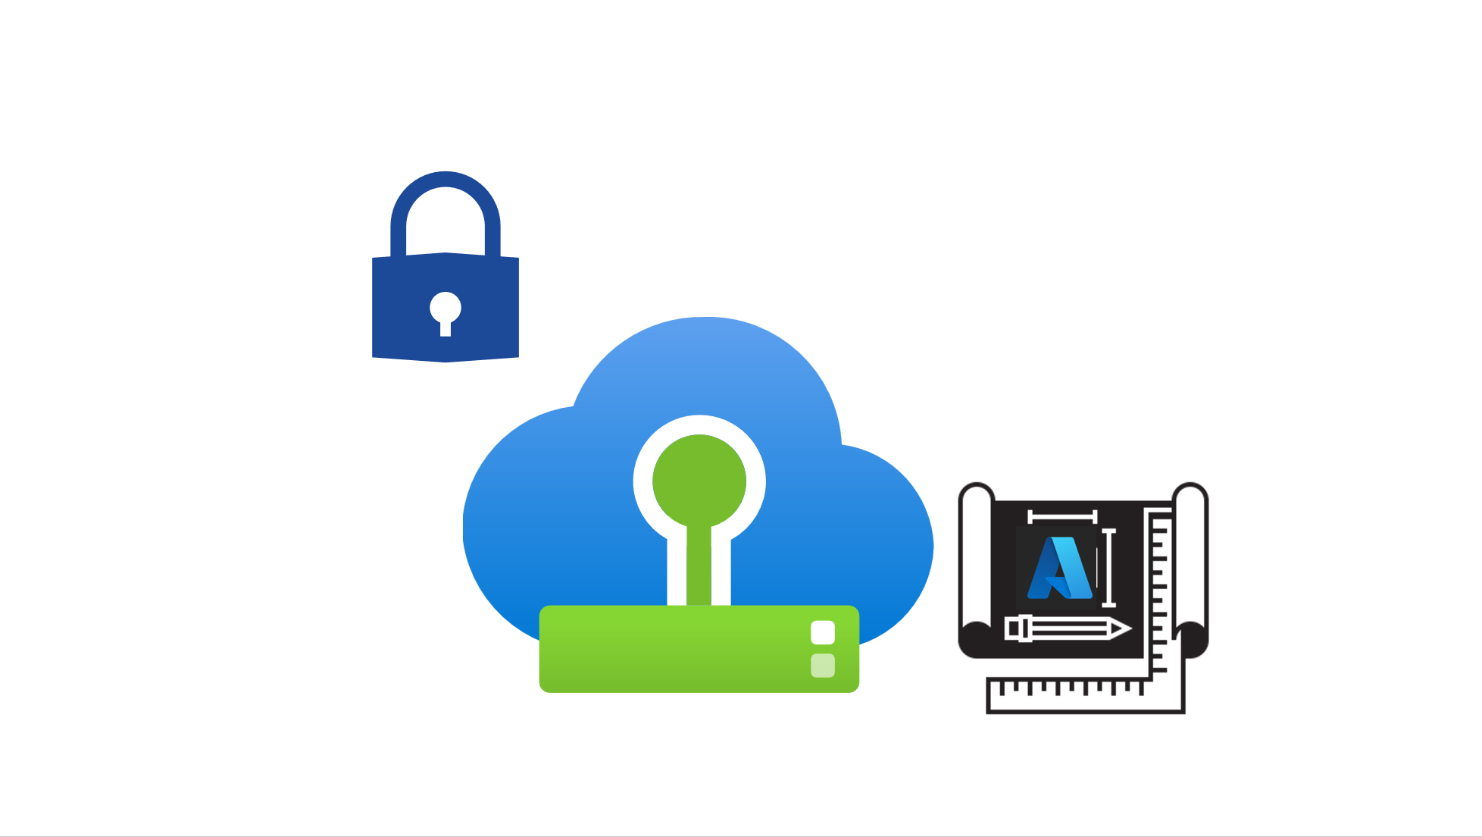

Slide 2




Users
Traffic Flow
Load Balancer Layer
Application
Security
Requirements
LB 1
LB 2
Web Layer
Web 1
Web 2
Web 3
App Layer
App 1
App 2
App 3
Database Layer
DB 1
(R/W)
DB 2
(R)
DB 3
(R)
Figure 1 – Typical Legacy Business-Critical Application Architecture

Slide 3










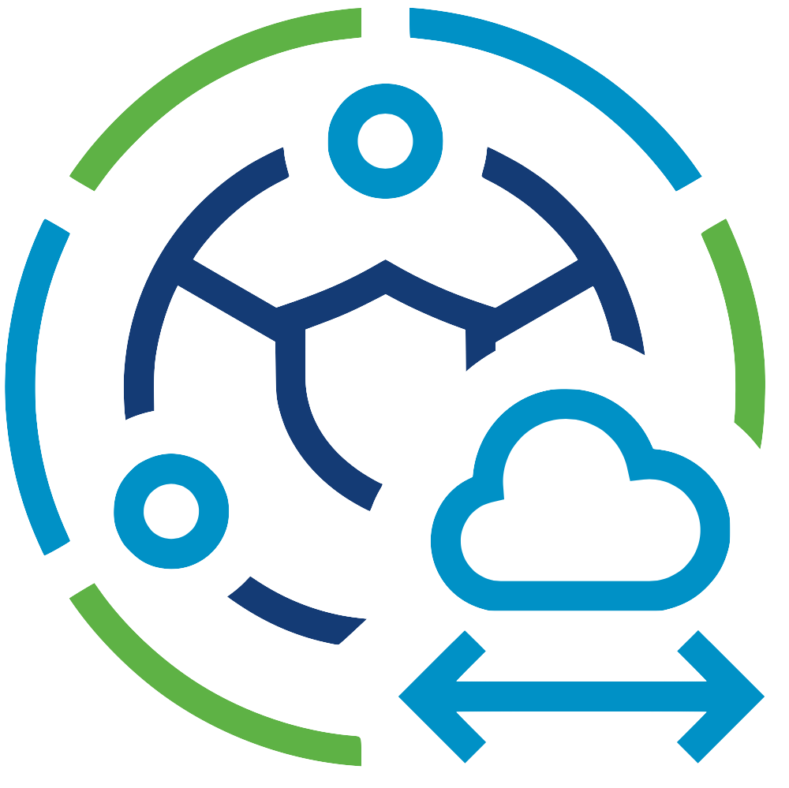




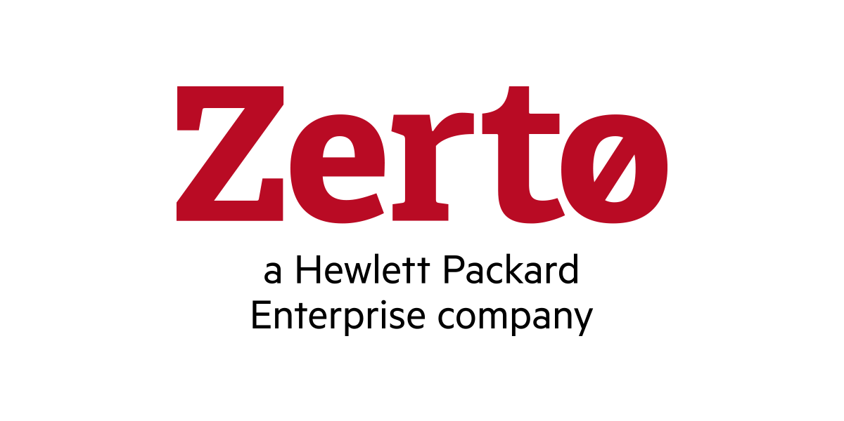




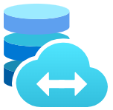

Microsoft Azure
Azure Subscription
Azure ExpressRoute
Dedicated Microsoft
Enterprise Edge
Azure Region
Azure Virtual Network
Azure Virtual WAN
Azure Resource Group
Azure Route Server
Azure Virtual Network
Gateway
Azure VMware Solution
Private Cloud
VMware HCX
VMware SRM
Azure VMware Solution
Resource Cluster
Zerto DR
VMware
vCenter Server
VMware NSX
JetStream
DR
Azure Bare-Metal
ESXi hosts
VMware
vSAN Datastore
Azure Bare-Metal
ESXi hosts
VMware
vSAN Datastore
Azure NetApp Files
Azure Elastic SAN
Pure Cloud Block Store
Figure 2 – Azure VMware Solution Architectural Components

Slide 4



JSON.string
Azure Log Analytics
JSON.string
Stream JSON.string
Azure Event Hub
Diagnostic
Setting
Azure VMware
Solution
JSON.string
Azure Blob Storage
Figure 4 – Azure VMware Solution Logging Options

Slide 5



Microsoft Azure
Azure VMware Solution
Private Cloud
Azure Bare-Metal
ESXi hosts
VMware
vSAN Datastore
VMware
vCenter Server
VMware NSX
VMware NSX
Edges
VMware HCX
VMware SRM
Get/Wrap/Unwrap
Authentication
Azure Key Vault
Microsoft Entra ID
Figure 5 – Customer Managed Keys with Azure VMware Solution

Slide 6
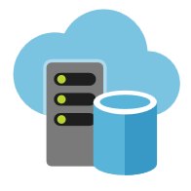
Internet
On-Premises, Co-Lo,
Non-Azure Clouds
Azure VMware Solution
Private Clouds
Microsoft Azure
Figure 6 – Zones of Trust

Slide 7
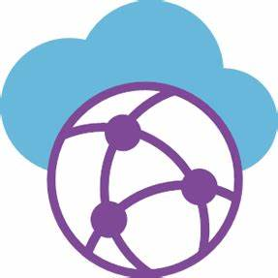
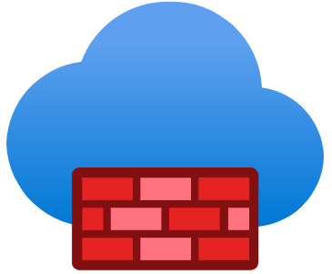



Microsoft Azure
Option 1
Option 2
Azure Secured vWAN
Hub
Azure Hub VNet
Azure Firewall
(WAF)
Azure Firewall
Azure ExpressRoute
Gateway
Azure ExpressRoute
Gateway
Option 3
Option 4
Azure VMware Solution
Private Cloud
Azure Hub VNet
NVA
Azure ExpressRoute
Gateway
Azure Route
Server
NVA
Figure 7 – Azure Firewall and 3rd party NVA options

Slide 8

Microsoft Azure
Azure ExpressRoute
Dedicated Microsoft
Enterprise Edge (D-MSEE)
Azure ExpressRoute
Gateway A
Azure Secured vWAN
Hub
Azure VMware Solution
Private Cloud
ExpressRoute Connection
Azure Firewall
Default Route
Global Reach
ExpressRoute Connection
Internet
Microsoft
Enterprise Edge (MSEE)
Azure Hub VNet
Azure Firewall
(WAF)
ExpressRoute Connection
Azure ExpressRoute
Gateway B
User Defined Routes
VNet Peering
Spoke VNets
Azure ExpressRoute
Customer Data Center
(On-Premises, or Co-Lo)
Azure Default Route blocked
by Route Policy
Customer Edge
Router
Figure 8 – Option 1: Secured Virtual WAN hub

Slide 9
Microsoft Azure
Azure ExpressRoute
Dedicated Microsoft
Enterprise Edge (D-MSEE)
Azure ExpressRoute
Gateway A
Azure Transit VNet
Azure VMware Solution
Private Cloud
ExpressRoute Connection
Azure Route
Server
NVA
(Transit)
User Defined Routes
VNet Peering
Internet
Microsoft
Enterprise Edge (MSEE)
Azure Hub VNet
ExpressRoute Connection
Azure ExpressRoute
Gateway B
Azure Route
Server
NVA
(FW)
User Defined Routes
VNet Peering
Spoke VNets
Azure ExpressRoute
Customer Data Center
(On-Premises, or Co-Lo)
Azure Default Route blocked
by Route Policy
Customer Edge
Router
Figure 9 – Option 2: Third-party Firewalls for all traffic

Slide 10



Microsoft Azure
Security Hub VNet (10.2.0.0/16)
VNet
peering
Spoke VNet 1 (10.4.0.0/16)
AS10100
GatewaySubnet
(10.4.0.0/24)
On-Premises
VMware vSphere
Data Center
VNet Gateway
GatewaySubnet
(10.2.4.0/24)
ExternalSubnet
(10.2.1.0/24)
InternalSubnet
(10.2.2.0/24)
ProtectedSubnet
(10.2.0.0/24)
RouteServerSubnet
(10.2.3.0/24)
Spoke VNet 1 (10.5.0.0/16)
ExpressRoute Connection
(10.220.0.0/22)
iBGP
eBGP
FortiNet FortiGate VM 1
GatewaySubnet
(10.5.0.0/24)
VNet
peering
VNet peering
Transit VNet (10.3.0.0/16)
eBGP
Azure Route Servers
Dedicated Microsoft Enterprise Edge Router (D-MSEE)
ExpressRoute Connection
ExternalSubnet
(10.3.1.0/24)
InternalSubnet
(10.3.2.0/24)
ProtectedSubnet
(10.3.0.0/24)
GatewaySubnet
(10.3.4.0/24)
RouteServerSubnet
(10.3.3.0/24)
Azure VMware Solution Private Cloud
AS10200
eBGP
VNet Gateway
VMware vSphere, vSAN
& NSX
FortiNet FortiGate VM 2
iBGP
(10.120.0.0/22)
Figure 10 – Example design of Option 2 with FortiNet FortiGate NVAs

Slide 11
Microsoft Azure
Azure ExpressRoute
Dedicated Microsoft
Enterprise Edge (D-MSEE)
Azure ExpressRoute
Gateway A
Azure Secured vWAN
Hub
Azure VMware Solution
Private Cloud
NVA
(FW)
ExpressRoute Connection
Azure Firewall
Default Route
Global Reach
ExpressRoute Connection
Internet
Microsoft
Enterprise Edge (MSEE)
Azure Hub VNet
Internet
(Managed SNAT)
Azure Firewall
(WAF)
ExpressRoute Connection
Azure ExpressRoute
Gateway B
User Defined Routes
VNet Peering
Spoke VNets
Azure ExpressRoute
Customer Data Center
(On-Premises, or Co-Lo)
Azure Default Route blocked
by Route Policy
Customer Edge
Router
Figure 11 – Option 3: Egress from Azure VMware Solution

Slide 12
Microsoft Azure
Azure ExpressRoute
Dedicated Microsoft
Enterprise Edge (D-MSEE)
Azure VMware Solution
Private Cloud
Global Reach
ExpressRoute Connection
Internet
Microsoft
Enterprise Edge (MSEE)
Azure Hub VNet
ExpressRoute Connection
Azure ExpressRoute
Gateway
Azure Route
Server
NVA
(FW)
User Defined Routes
VNet Peering
Spoke VNets
Azure ExpressRoute
Customer Data Center
(On-Premises, or Co-Lo)
Azure Default Route blocked
by Route Policy
Customer Edge
Router
Figure 12 – Option 4: Third-party Firewall for internet traffic

Slide 13
Microsoft Azure
Azure
ExpressRoute
Azure VMware Solution
Private Cloud
NSX Unified
Appliance 1
(NSX-APP01)
VMware NSX
Edge 1
(EVM01)
Tier-0 Gateway
Provider Router
(Customer can apply Gateway Firewall policies)
Tier-1 Gateway
NSX Unified
Appliance 2
(NSX-APP02)
VMware NSX
Edge 2
(EVM02)
Azure Bare-Metal
ESXi hosts with
NSX VIBs
Network Segments
NSX Unified
Appliance 3
(NSX-APP03)
Customer
Controlled
Figure 13 – VMware NSX Gateway Firewall policies for North-South traffic

Slide 14
Microsoft Azure
Azure
ExpressRoute
Azure VMware Solution
Private Cloud
NSX Unified
Appliance 1
(NSX-APP01)
VMware NSX
Edge 1
(EVM01)
Tier-0 Gateway
Azure Bare-Metal
ESXi hosts with
NSX VIBs
Micro-segmentation
Distributed Firewall
Tier-1 Gateway
NSX Unified
Appliance 2
(NSX-APP02)
VMware NSX
Edge 2
(EVM02)
Network Segments
NSX Unified
Appliance 3
(NSX-APP03)
Figure 14 – VMware NSX Micro-segmentation (DFW) for East-West traffic

Slide 15





On-Premises Environment
Azure Sentinel
Gold SLA Apps
Silver SLA Apps
Bronze SLA Apps
Enterprise
Services
Log Analytics Agents
Azure Log Analytics Workspace
Log Analytics Agents
Azure VMware Solution
Private Cloud
Azure Security Center
Gold SLA Apps
Silver SLA Apps
Bronze SLA Apps
Enterprise
Services
Figure 15 – Microsoft Defender for Cloud with Azure VMware Solution

Slide 16



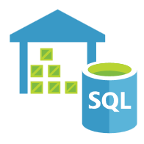

Microsoft Azure
Dedicated Microsoft
Enterprise Edge (D-MSEE)
Azure ExpressRoute
Azure VNet
Azure VMware Solution
Private Cloud
ExpressRoute Connection
Azure Services
Azure ExpressRoute
Gateway
Azure Bare-Metal
ESXi hosts
VMware
vSAN Datastore
VMware
vCenter Server
VMware NSX
Global Reach
Default Route published from
the connections you make to the Private Cloud
Microsoft
Enterprise Edge (MSEE)
VMware NSX
Edges
VMware HCX
VMware SRM
Azure ExpressRoute
Customer vSphere Environment
(On-Premises, Co-Lo, or Cloud-based)
Customer Edge
Router
Bare-Metal
ESXi hosts
vCenter
Server
vSphere
Datastores
vSphere
Networks
Figure 16 – Azure VMware Solution Internet Disabled

Slide 17
Microsoft Azure
Internet
Outbound Internet Access Only
Managed SNAT
Azure
ExpressRoute
Azure VMware Solution
Private Cloud
VMware NSX
Tier-0 Gateway
Tier-1 Gateway
Figure 17 – Azure VMware Solution Managed SNAT Internet Access

Slide 18
Microsoft Azure
Internet
Azure PIP range is advertised to Internet with ASN of NSX Tier-0 Gateway
Traffic flow
Azure
ExpressRoute
Network Virtual Appliance (NVA)
e.g. Palo Alto Networks,
FortiNet FortiGate,
Barracuda FW,
CheckPoint FW, or
F5 Networks BIG-IP
Azure VMware Solution
Private Cloud
BGP ASN
VMware NSX
Tier-0 Gateway
Azure PIP range needs to be consumed within the Tier-1 Gateway or Network Segment
Azure Public IP
Address Range
Tier-1 Gateway
Figure 18 – Azure VMware Solution VMware NSX Public IP Address (PIP)

Slide 19

1. PIP enabled in Azure Portal
Azure VMware Solution
Private Cloud
VMware NSX
T0 Gateway
11. Firewall rules
T1 Gateway
2. DMZ network segment
Public IP subnet assigned
10. CheckPoint SNAT configured
9. CheckPoint Default route to T1 Gateway
6. CheckPoint NVA cluster
8. CheckPoint Static routes to
T1 Gateway for network segments
3. Inside network segment
7. Default route to CheckPoint VIP
5. T1 Gateway – CheckPoint inside networks
4. Checkpoint protected network segments
Figure 19 – VMware NSX T1 Gateway Sandwich with CheckPoint

